Slide 1
Chapter 4 – Continuous Random Variables and Probability Distributions

Slide 2
Outline
Continuous random variables and probability density functions
The Cumulative Distribution Function and Expected Values
The Normal Distribution
The Gamma Distributions and its relatives
Probability plots

Slide 3
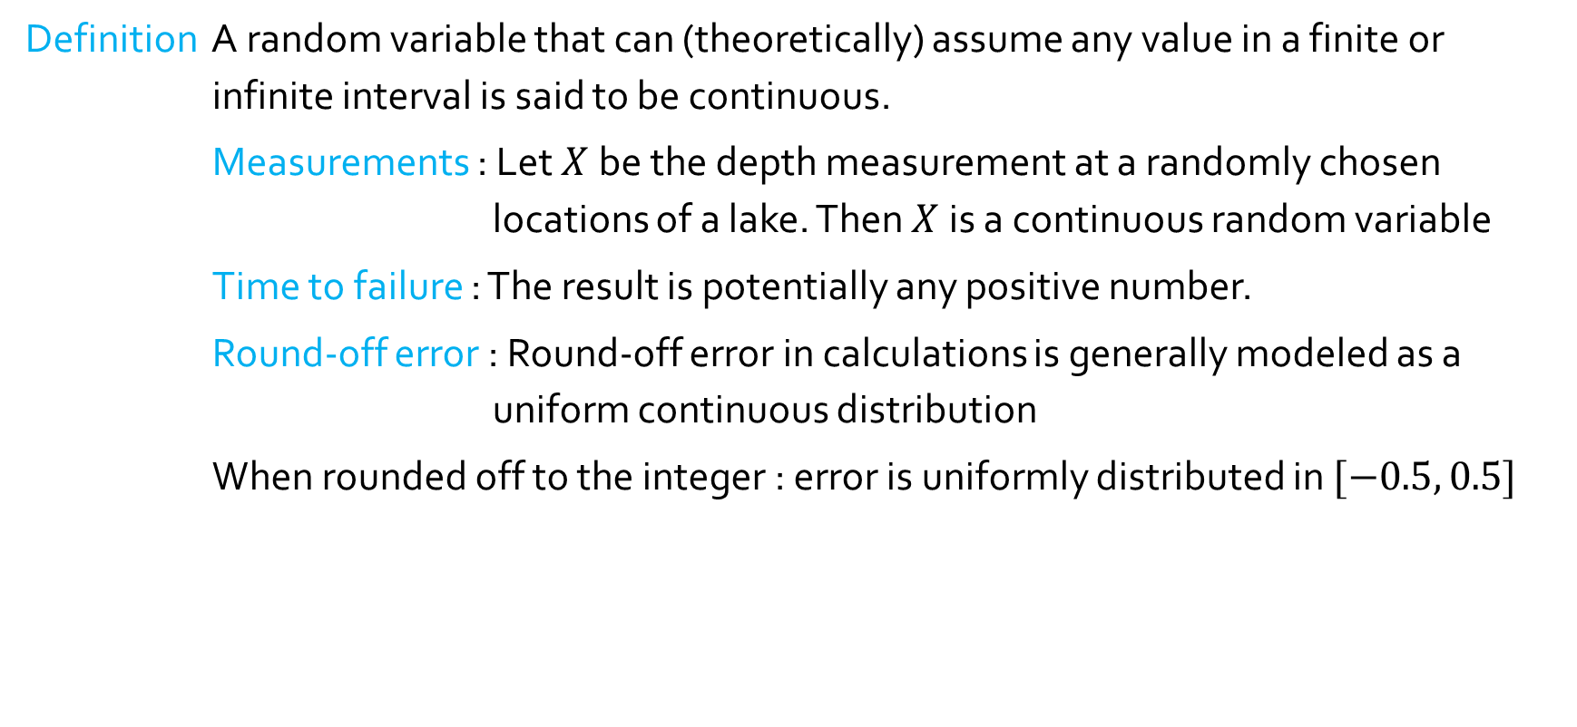
Continuous Random Variables
Definition A random variable that can (theoretically) assume any value in a finite or infinite interval is said to be continuous.
Measurements : Let $X$be the depth measurement at a randomly chosen locations of a lake. Then $X$is a continuous random variable
Time to failure : The result is potentially any positive number.
Round-off error : Round-off error in calculations is generally modeled as a uniform continuous distribution
When rounded off to the integer : error is uniformly distributed in $[−0.5, 0.5]$
-0.5
0.5

Slide 4
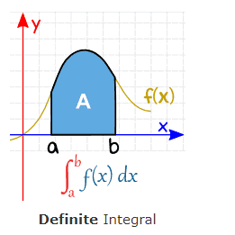
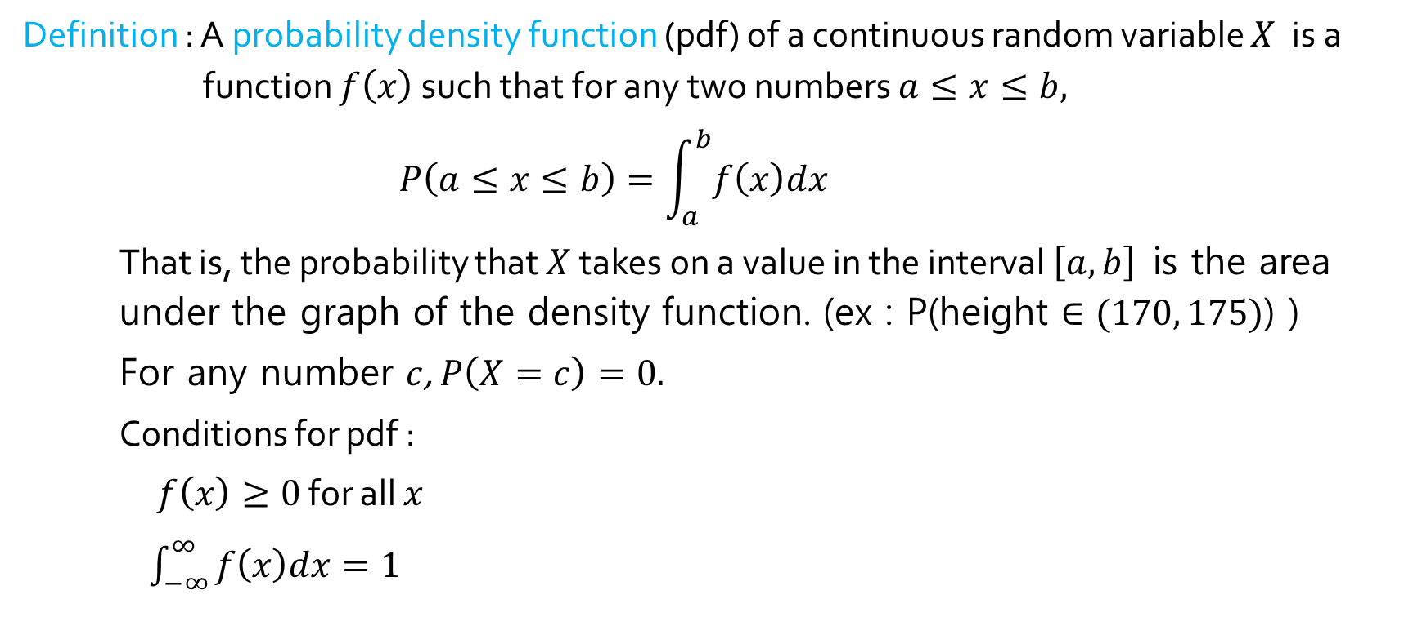
Probability density function
Definition : A probability density function (pdf) of a continuous random variable $X$ is a function $f\left(x\right)$ such that for any two numbers $a≤x≤b,$
$$P\left(a≤x≤b\right)=\int_{a}^{b}{f\left(x\right)dx}$$
That is, the probability that $X$ takes on a value in the interval $\left[a, b\right]$ is the area under the graph of the density function. (ex : P(height $∈(170, 175)$) )
For any number $c$, $P\left(X=c\right)=0.$
Conditions for pdf :
$f\left(x\right)≥0$ for all $x$
$\int_{−∞}^{∞}{f\left(x\right)dx=1}$

Slide 5
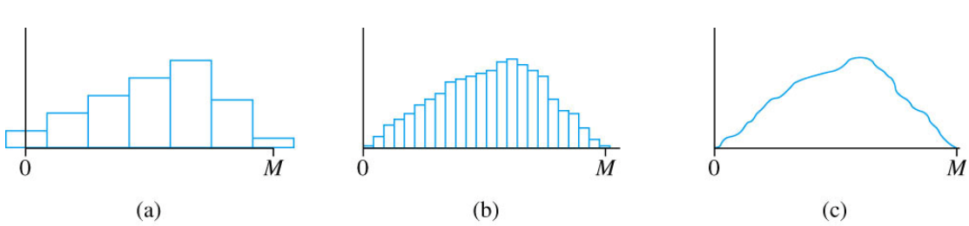
Motivating probability density function
The probability density function can be viewed as a limit of discrete histograms.
Consider the lake depth measurement example.
We “discretize” X by measuring the depth to the nearest meter, nearest centimeter, and so on.
As we measure depth more and more finely, the resulting sequence of histograms approaches a smooth curve. This is the pdf.

Slide 6
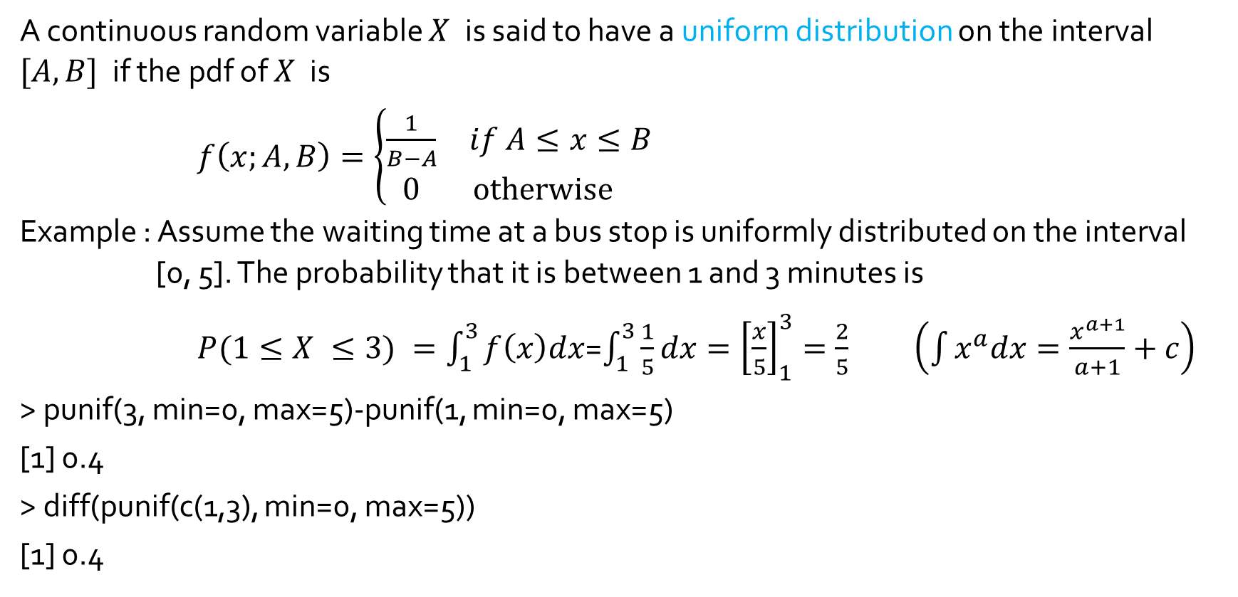
Uniform distribution
A continuous random variable $X$ is said to have a uniform distribution on the interval $[A, B]$if the pdf of $X$ is
$f\left(x;A, B\right)=\left\{\begin{matrix}\frac{1}{B−A} & if A≤x≤B \\ 0 & otherwise \end{matrix}\right.$
Example : Assume the waiting time at a bus stop is uniformly distributed on the interval [0, 5]. The probability that it is between 1 and 3 minutes is
$P(1≤X ≤3) =\int_{1}^{3}{f\left(x\right)dx}$=$\int_{1}^{3}{\frac{1}{5}dx{=\left[\frac{x}{5}\right]}_{1}^{3}}=\frac{2}{5}$ $\left(\int{x^{a}dx=\frac{x^{a+1}}{a+1}+c}\right)$
> punif(3, min=0, max=5)-punif(1, min=0, max=5)
[1] 0.4
> diff(punif(c(1,3), min=0, max=5))
[1] 0.4
0
1
3
5

Slide 7
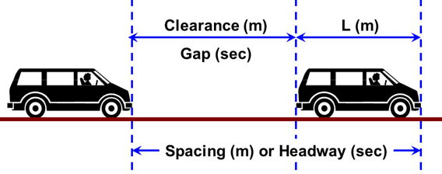
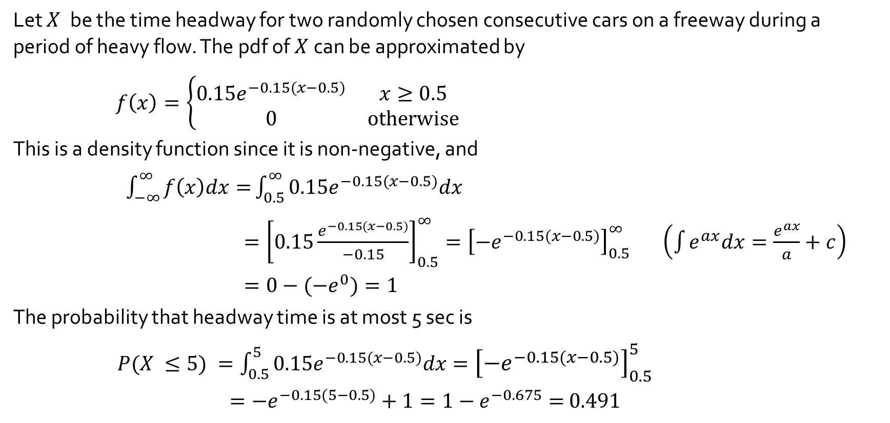
Example 4.5
Let $X$ be the time headway for two randomly chosen consecutive cars on a freeway during a period of heavy flow. The pdf of $X$can be approximated by
$f\left(x\right)=\left\{\begin{matrix}{0.15e}^{−0.15(x−0.5)} & x≥0.5 \\ 0 & otherwise\end{matrix}\right.$
This is a density function since it is non-negative, and
$\int_{−∞}^{∞}{f\left(x\right)dx=}\int_{0.5}^{∞}{{0.15e}^{−0.15(x−0.5)}dx}$
$={\left[0.15\frac{e^{−0.15(x−0.5)}}{−0.15}\right]}_{0.5}^{∞}={\left[−e^{−0.15(x−0.5)}\right]}_{0.5}^{∞}$ $\left(\int{e^{ax}dx=\frac{e^{ax}}{a}+c}\right)$
$=0−(−e^{0})=1$
The probability that headway time is at most 5 sec is
$P(X ≤5) =\int_{0.5}^{5}{{0.15e}^{−0.15(x−0.5)}dx={\left[{−e}^{−0.15(x−0.5)}\right]}_{0.5}^{5}}$
$={−e}^{−0.15(5−0.5)}+1=1−e^{−0.675}=$ $0.491$

Slide 8
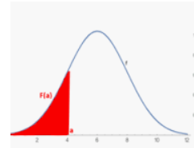
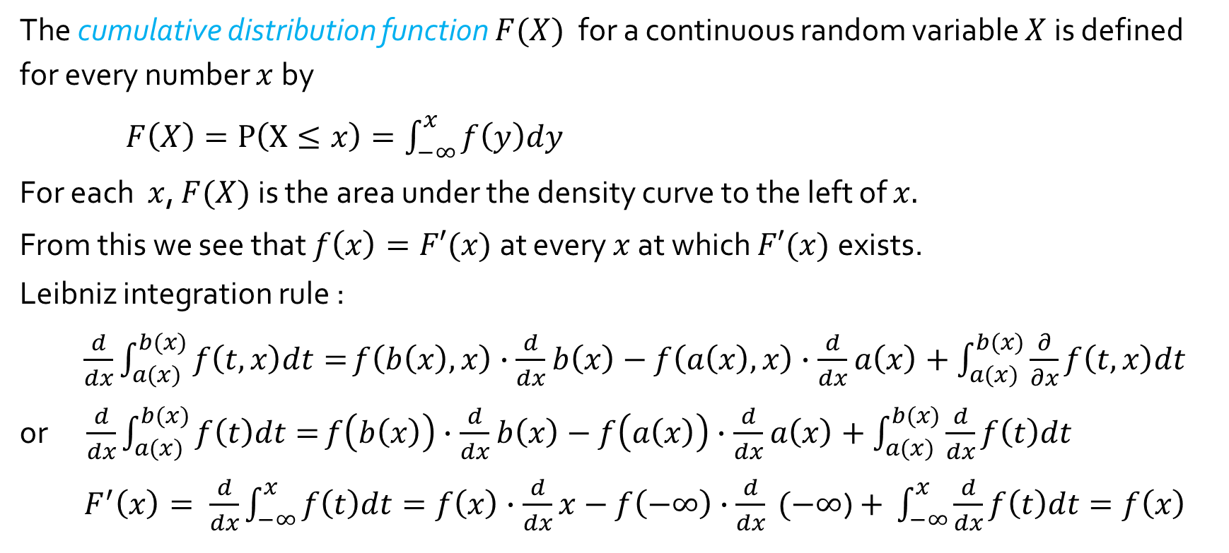
The cumulative distribution function
The cumulative distribution function $F(X)$ for a continuous random variable $X$is defined for every number $x$by
$F\left(X\right)=P\left(X≤x\right)=\int_{−∞}^{x}{f\left(y\right)dy}$
For each $x$, $F(X)$is the area under the density curve to the left of $x.$
From this we see that $f\left(x\right)=F′(x)$at every $x$ at which $F′(x)$exists.
Leibniz integration rule :
$\frac{d}{dx}\int_{a(x)}^{b(x)}{f\left(t,x\right)dt=}f\left(b\left(x\right),x\right)∙\frac{d}{dx}$ $b\left(x\right)−f\left(a\left(x\right),x\right)∙\frac{d}{dx}$ $a\left(x\right)+\int_{a(x)}^{b(x)}{\frac{∂}{∂x}f\left(t,x\right)dt }$
or $\frac{d}{dx}\int_{a(x)}^{b(x)}{f\left(t\right)dt=}f\left(b\left(x\right)\right)∙\frac{d}{dx}$ $b\left(x\right)−f\left(a\left(x\right)\right)∙\frac{d}{dx}$ $a\left(x\right)+\int_{a(x)}^{b(x)}{\frac{d}{dx}f\left(t\right)dt }$
$F^{′}\left(x\right)= \frac{d}{dx}\int_{−∞}^{x}{f\left(t\right)dt}=f\left(x\right)∙\frac{d}{dx}$ $x−f\left(−∞\right)∙\frac{d}{dx} (−∞$) $+ \int_{−∞}^{x}{\frac{d}{dx}f\left(t\right)dt}=f\left(x\right)$

Slide 9
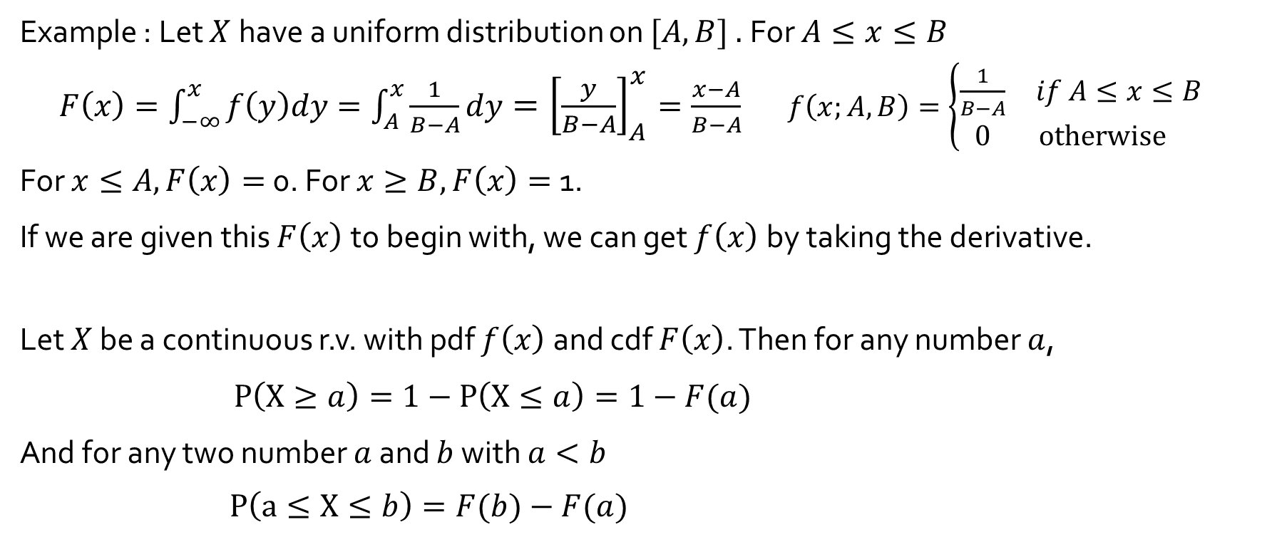
Computing probabilities using the cdf
Example : Let $X$ have a uniform distribution on $[A, B] .$For $A≤x≤B$
$F\left(x\right)=\int_{−∞}^{x}{f\left(y\right)dy}=\int_{A}^{x}{\frac{1}{B−A}dy={\left[\frac{y}{B−A}\right]}_{A}^{x}=\frac{x−A}{B−A}}$ $f\left(x;A, B\right)=\left\{\begin{matrix}\frac{1}{B−A} & if A≤x≤B \\ 0 & otherwise \end{matrix}\right.$
For $x≤A, F\left(x\right)=$0. For $x≥B, F\left(x\right)=$1.
If we are given this $F\left(x\right)$to begin with, we can get $f\left(x\right)$by taking the derivative.
Let $X$ be a continuous r.v. with pdf $f\left(x\right)$ and cdf $F\left(x\right)$. Then for any number $a$,
$P\left(X≥a\right)=1−P\left(X≤a\right)=1−F(a)$
And for any two number $a$ and $b$ with $a<b$
$P\left(a≤X≤b\right)=F(b)−F(a)$

Slide 10
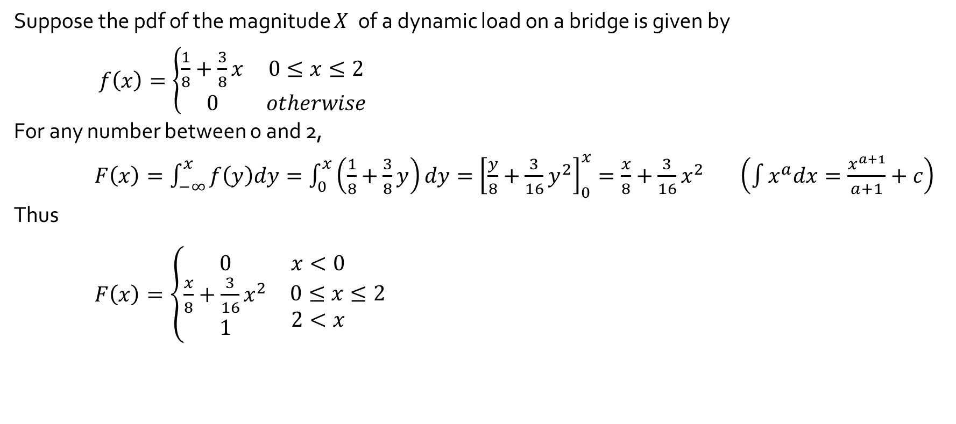
Example 4.7
Suppose the pdf of the magnitude $X$ of a dynamic load on a bridge is given by
$f\left(x\right)=\left\{\begin{matrix}\frac{1}{8}+\frac{3}{8}x & 0≤x≤2 \\ 0 & otherwise\end{matrix}\right.$
For any number between 0 and 2,
$F\left(x\right)=\int_{−∞}^{x}{f\left(y\right)dy}=\int_{0}^{x}{\left(\frac{1}{8}+\frac{3}{8}y\right)dy={\left[\frac{y}{8}+\frac{3}{16}y^{2}\right]}_{0}^{x}=\frac{x}{8}+\frac{3}{16}x^{2}}$ $\left(\int{x^{a}dx=\frac{x^{a+1}}{a+1}}+c\right)$
Thus
$F\left(x\right)=\left\{\begin{matrix}0 & x<0 \\ \begin{matrix}\frac{x}{8}+\frac{3}{16}x^{2} \\ 1\end{matrix} & \begin{matrix}0≤x≤2 \\ 2<x \end{matrix}\end{matrix}\right.$

Slide 11

Example 4.7
The probability that the load is between 1 and 1.5 is $(F\left(x\right)=\frac{x}{8}+\frac{3}{16}x^{2})$
$P\left(1≤X≤1.5\right)=F(1.5)−F(1)$
$=\left(\frac{1.5}{8}+\frac{3}{16}{1.5}^{2}\right)−\left(\frac{1}{8}+\frac{3}{16}1^{2}\right)=$0.297
The probability that the load exceeds 1 is
$P\left(X>1\right)=1−F(1)$ $=1−\left(\frac{1}{8}+\frac{3}{16}1^{2}\right)=$0.688

